Slide 2
SPARK 2014 – Formal Verification Made Easy
Yannick Moy
October 1st 2015

Slide 3
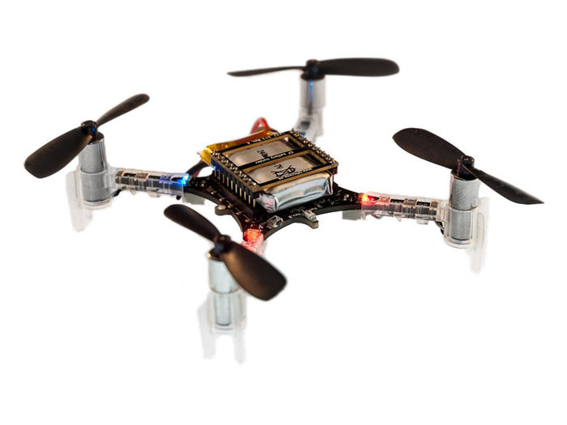
Crazyflie 2.0
1800 sloc stabilization in C
+ FreeRTOS
+ …

Slide 4

2 months later…
Crazyflie 2.0
1800 sloc stabilization in C
+ FreeRTOS
+ …
Crazyflie in Ada/SPARK
2100 sloc stabilization in SPARK
proved no run-time errors!
+ FreeRTOS
+ …

Slide 5
5 months later…
Crazyflie 2.0
1800 sloc stabilization in C
+ FreeRTOS
+ …
Crazyflie in Ada/SPARK
2100 sloc stabilization in SPARK
proved no run-time errors!
+ Ravenscar
will prove
no concurrency errors!

Slide 6
Easy to Adopt
Gradual adoption
SPARK is just Ada!
Some units in SPARK, others in Ada
Inside units, parts in SPARK and parts in Ada
Integrated in developer’s toolbox
Based on GNAT projects
SPARK tools integrated in GPS and Eclipse GNATbench

Slide 7
Easy to Use
Incremental benefits
Usable without upfront work (no contracts)
Increasing benefits with more contracts
Highly interactive
Run at different levels of granularity (down to single line)
Run at different levels of power
Get precise results in GPS or GNATbench
Features to query results (paths, counterexamples)

Slide 8
Multiple Use Cases (1/2)
Safe coding standard for critical (embedded) software
Increases portability across compilers/platforms
Address data and control coupling
Prove absence of run-time errors (AoRTE)
Few contracts required
Typically 95% - 98% of RTE proved
Proof can be completed by testing

Slide 9
Multiple Use Cases (1/2)
Safe coding standard for critical (embedded) software
Increases portability across compilers/platforms
Address data and control coupling
Prove absence of run-time errors (AoRTE)
Few contracts required
Typically 95% - 98% of RTE proved
Proof can be completed by testing

Slide 10
Multiple Use Cases (2/2)
Prove correct integration between components
In replacement of defensive coding
Simple contracts are needed
Prove functional correctness (including input partitioning)
In replacement of unit testing
More complex contracts are needed
Safe optimization of run-time checks

Slide 11
Combining Proof and Test
At the level of individual runtime checks
Possible RTE covered by tests
Also the approach in VectorCAST with CodePeer
Between proof and integration testing
Contract used for AoRTE at unit level
Same contract used for integration testing (no unit tests)
Between proof and unit testing
Contract as boundary between proof and unit test
Very relevant in DO-178C context for avionics

Slide 12
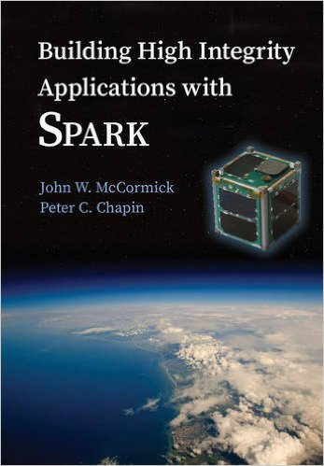
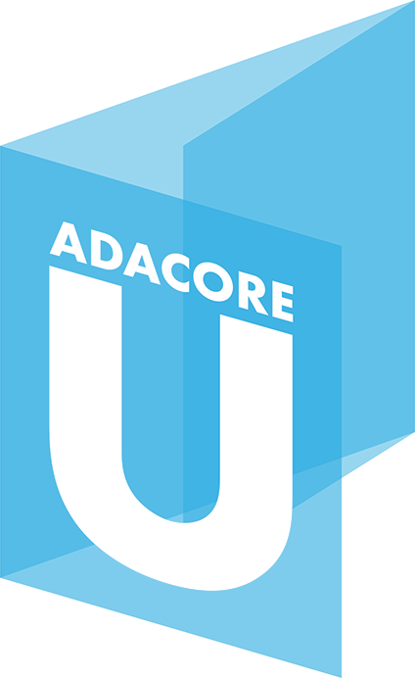
Learning SPARK: Contracts
Overview of SPARK Language (SPARK User’s Guide)
Subprogram contracts
Package contracts
Type contracts
Tagged Types and Liskov Substitution Principle
SPARK Book (McCormick & Chapin)
SPARK Courses
Tutorials, webinars, trainings
AdaCore University (u.adacore.com)

Slide 13
Learning SPARK: GNATprove
Formal Verification with GNATprove (SPARK User’s Guide)
Running the tool and viewing results, but also…
How to use GNATprove in a team
How to write subprogram contracts
How to investigate unproved checks
…
GNATprove by Example (SPARK User’s Guide)
SPARK Book and Courses

Slide 14
In The Next Release
New language features
Support for Ravenscar profile of tasking
Support for ghost code
Support for type predicates
Improved provability
New provers CVC4 and Z3 (in addition to Alt-Ergo)
Much better handling of bitwise and floats
Improved interaction
Generation of counterexamples when not proved

Slide 15
In The Next Release
New language features
Support for Ravenscar profile of tasking
Support for ghost code
Support for type predicates
Improved provability
New provers CVC4 and Z3 (in addition to Alt-Ergo)
Much better handling of bitwise and floats
Improved interaction
Generation of counterexamples when not proved

Slide 16
Support for Ghost Code
^{contracts}
ghost
functions
with assertions
+
^{code}
compile
^{executable}
used in formal + test

Slide 17
Support for Ghost Code
^{contracts}
ghost
functions
with assertions
+
ghost
variables,
types,
procedures
^{code}
compile
^{executable}
used in formal + test

Slide 18
Support for Ghost Code
^{contracts}
ghost
functions
with assertions
+
ghost
variables,
types,
procedures
^{code}
compile
^{executable}
removed in final build

Slide 19
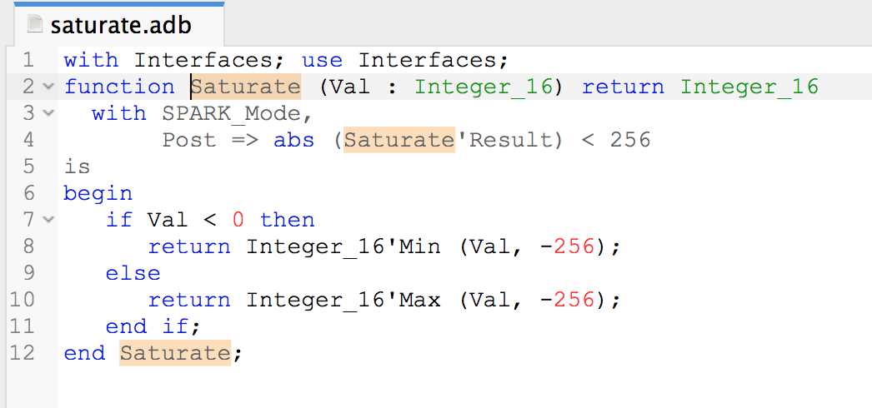
Generation of Counterexamples

Slide 20
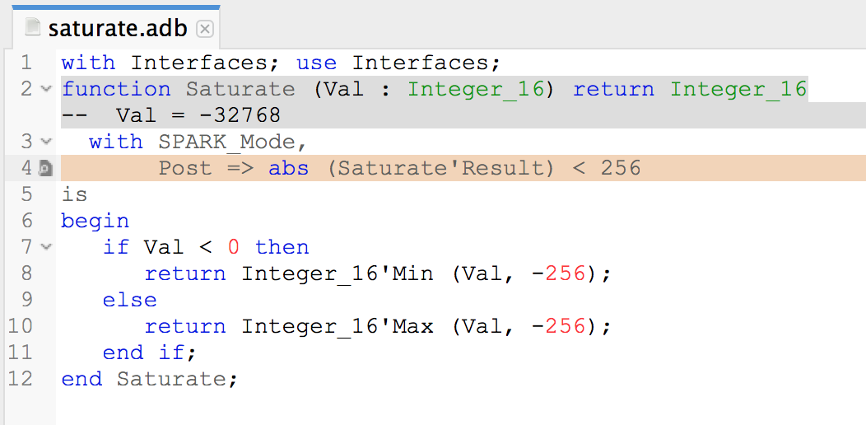
Generation of Counterexamples
saturate.adb:4:16: medium: overflow check might fail

Slide 21

Generation of Counterexamples
saturate.adb:4:16: medium: overflow check might fail

Slide 22
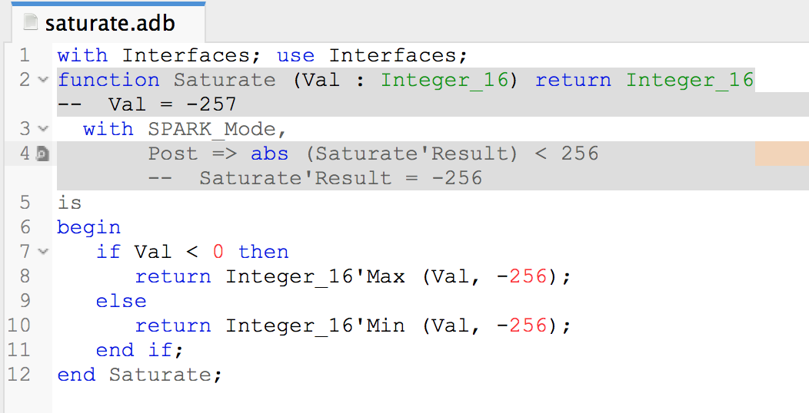
Generation of Counterexamples
saturate.adb:4:16: medium: postcondition might fail

Slide 23
Generation of Counterexamples
saturate.adb:4:16: medium: postcondition might fail

Slide 24
Beyond The Next Release
New language features
Support for type invariants
Support for simple pointers
Improved provability
Integration of CodePeer static analysis in GNATprove
Improved interaction
Better integration between SPARK and C
Metrics and indicators for formal developments

Slide 25
SPARK Is Good For You…
If you want to get guarantees about your software
At a reasonable cost
With your existing team / tools / processes
… We’re here to help!
Notes:
Summarize presentation content by restating the important points from the lessons.
What do you want the audience to remember when they leave your presentation?

Slide 26


Resources
SPARK Pro webpage
http://www.adacore.com/sparkpro
SPARK community page
http://www.spark-2014.org
SPARK User’s Guide
http://docs.adacore.com/spark2014-docs/html/ug
AdaCore University
http://u.adacore.com

